Slide 1
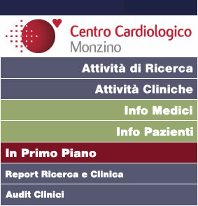
INCRETINE E PROTEZIONE CARDIOVASCOLARE:
ULTIME EVIDENZE
Giancarlo Marenzi

Slide 2
Life expectancy decreases as BMI increases
100
Normal BMI =
almost 80% chance
of reaching age 70
80
60
BMI 35–40 =
~60% chance of reaching age 70
Proportion still alive (%)
40
BMI range (kg/m²)
22.5–25
BMI 40–50 =
~50% chance of reaching age 70
25–30
20
30–35
35–40
40–50
0
35
40
50
60
70
80
90
100
Age (years)
Data are based on male subjects; n=541,452
Prospective Studies Collaboration. Lancet 2009

Slide 3
CVD is the primary cause of mortality in obesity
Association between maximum BMI
and mortality due to CVD, n=225,072
Underweight
(BMI <18.5 kg/m²)
Healthy weight
(BMI 18.5–<25 kg/m²)
Overweight
(BMI 25–<30 kg/m²)
Obesity class I
(BMI 30–<35 kg/m²)
Obesity class ≥II
(BMI ≥35 kg/m²)
Hazard ratio
Comparator = healthy weight
Yu et al. Ann Intern Med 2017

Slide 4
Greater risk of developing T2D with higher BMI
Relative risk of developing T2D with:
BMI 29.0–30.9 kg/m² = 28*
BMI 31.0–32.9 kg/m² = 40*
BMI 33.0–34.9 kg/m² = 54*
BMI ≥35 kg/m² = 93*
Age-adjusted relative risk
of developing T2D*
BMI (kg/m²)
*vs. BMI <22 kg/m²;
Colditz et al. Ann Intern Med 1995
Notes:
Diabetes and BMI was self-reported
Colditz et al. Ann Intern Med 1995;122:481–6.
Abstract
OBJECTIVE:
To examine the relation between adult weight change and the risk for clinical diabetes mellitus among middle-aged women.
DESIGN:
Prospective cohort study with follow-up from 1976 to 1990.
SETTING:
11 U.S. states.
PARTICIPANTS:
114,281 female registered nurses aged 30 to 55 years who did not have diagnosed diabetes mellitus, coronary heart disease, stroke, or cancer in 1976.
OUTCOME MEASURES:
Non-insulin-dependent diabetes mellitus.
RESULTS:
2204 cases of diabetes were diagnosed during 1.49 million person-years of follow-up. After adjustment for age, body mass index was the dominant predictor of risk for diabetes mellitus. Risk increased with greater body mass index, and even women with average weight (body mass index, 24.0 kg/m2) had an elevated risk. Compared with women with stable weight (those who gained or lost less than 5 kg between age 18 years and 1976) and after adjustment for age and body mass index at age 18 years, the relative risk for diabetes mellitus among women who had a weight gain of 5.0 to 7.9 kg was 1.9 (95% CI, 1.5 to 2.3). The corresponding relative risk for women who gained 8.0 to 10.9 kg was 2.7 (CI, 2.1 to 3.3). In contrast, women who lost more than 5.0 kg reduced their risk for diabetes mellitus by 50% or more. These results were independent of family history of diabetes.
CONCLUSION:
The excess risk for diabetes with even modest and typical adult weight gain is substantial. These findings support the importance of maintaining a constant body weight throughout adult life and suggest that the 1990 U.S. Department of Agriculture guidelines that allow a substantial weight gain after 35 years of age are misleading.

Slide 5
Individuals with high BMI are more likely to develop hypertension than healthy subjects
3.0
2.5
2.0
Relative risk
1.5
p for trend < 0.001
1.0
0.5
<21.6
21.6–22.3
22.4–23.0
23.1–23.6
23.7–24.2
24.3–24.7
24.8–25.4
25.5–26.3
26.4–27.8
>27.8
BMI (kg/m²)
adjusted for baseline age, cigarette smoking, alcohol intake, exercise, parental history of MI, history of DM and elevated cholesterol
Gelber et al. Am J Hypertens 2007
Notes:
Multivariable-adjusted relative risk of developing hypertension, according to baseline
body mass index decile (BMI kg/m²)
Adjusted for baseline age, cigarette smoking, alcohol consumption, exercise, parental history of myocardial infarction before the age of 60 years, history of diabetes, and elevated cholesterol. Referent group (RR=1.0): BMI <21.6 kg/m² at baseline. P for trend <0.001.
Other studies have shown:
Approximately 50% of obese individuals have hypertension^{1,2}
Overweight individuals are three times more likely to develop hypertension than healthy individuals, with the risk increasing with increasing body mass index (BMI)^{3,4}
60–70% of hypertension may be attributed to obesity⁵
The Framingham Heart Study (n=2923; mean age: 54 years; 51% women) determined a 5% weight gain was associated with 20–30% increase in high BP incidence⁶
Visceral fat (central obesity) is a more important determinant of high BP than peripheral fat⁷
1. Kuczmarski et al. Obes Res 1997;5:542–8; 2. Sjostrom et al. N Engl J Med 2004;351:2683; 3. Patterson et al. Am J Prev Med 2004;27:385–90; 4. Gelber et al. Am J Hypertens. 2007;20:370–7; 5. Jordan et al. J Hypertens 2007;25:897–900; 6. Vasan et al. Lancet 2001;358:1682-6; 7. Kotchen. Am J Hypertens 2010;23:1170–82
Gelber et al. Am J Hypertens 2007;20:370–7.
Abstract
BACKGROUND:
Although obesity is known to increase the risk of hypertension, few studies have prospectively evaluated body mass index (BMI) across the range of normal weight and overweight as a primary risk factor.
METHODS:
In this prospective cohort, we evaluated the association between BMI and risk of incident hypertension. We studied 13,563 initially healthy, nonhypertensive men who participated in the Physicians' Health Study. We calculated BMI from self-reported weight and height and defined hypertension as self-reported systolic blood pressure (BP) > or = 140 mm Hg, diastolic BP > or = 90 mm Hg, or new antihypertensive medication use.
RESULTS:
After a median 14.5 years, 4920 participants developed hypertension. Higher baseline BMI, even within the "normal" range, was consistently associated with increased risk of hypertension. Compared to participants in the lowest BMI quintile (<22.4 kg/m(2)), the relative risks (95% confidence interval) of developing hypertension for men with a BMI of 22.4 to 23.6, 23.7 to 24.7, 24.8 to 26.4, and >26.4 kg/m(2) were 1.20 (1.09-1.32), 1.31 (1.19-1.44), 1.56 (1.42-1.72), and 1.85 (1.69-2.03), respectively (P for trend, <.0001). Further adjustment for diabetes, high cholesterol, and baseline BP did not substantially alter these results. We found similar associations using other BMI categories and after excluding men with smoking history, those who developed hypertension in the first 2 years, and those with diabetes, obesity, or high cholesterol at baseline.
CONCLUSIONS:
In this large cohort, we found a strong gradient between higher BMI and increased risk of hypertension, even among men within the "normal" and mildly "overweight" BMI range. Approaches to reduce the risk of developing hypertension may include prevention of overweight and obesity.

Slide 6
The prevalence of hypertension increases with increasing BMI
Hypertension
No hypertension
100
p for trend < 0.001
80
60
Prevalence (%)
40
20
0
Normal weight
Overweight
Obesity class l
Obesity class ll
Obesity class lll
Landi et al. Nutrients 2018

Slide 7
Progressive rise of the total cholesterol and triglycerides with increasing BMI
6.6
Total cholesterol
6.2
Triglycerides
HDL cholesterol
5.8
2.8
Concentration of
blood lipids (mmol/L)
2.4
2.0
1.6
1.2
0
18
20
22
24
26
28
30
32
34
BMI (kg/m²)
Data are based on UK males aged 40–59 year
James et al. Comparative Quantification of Health Risks. WHO 2004
Notes:
7

Slide 8
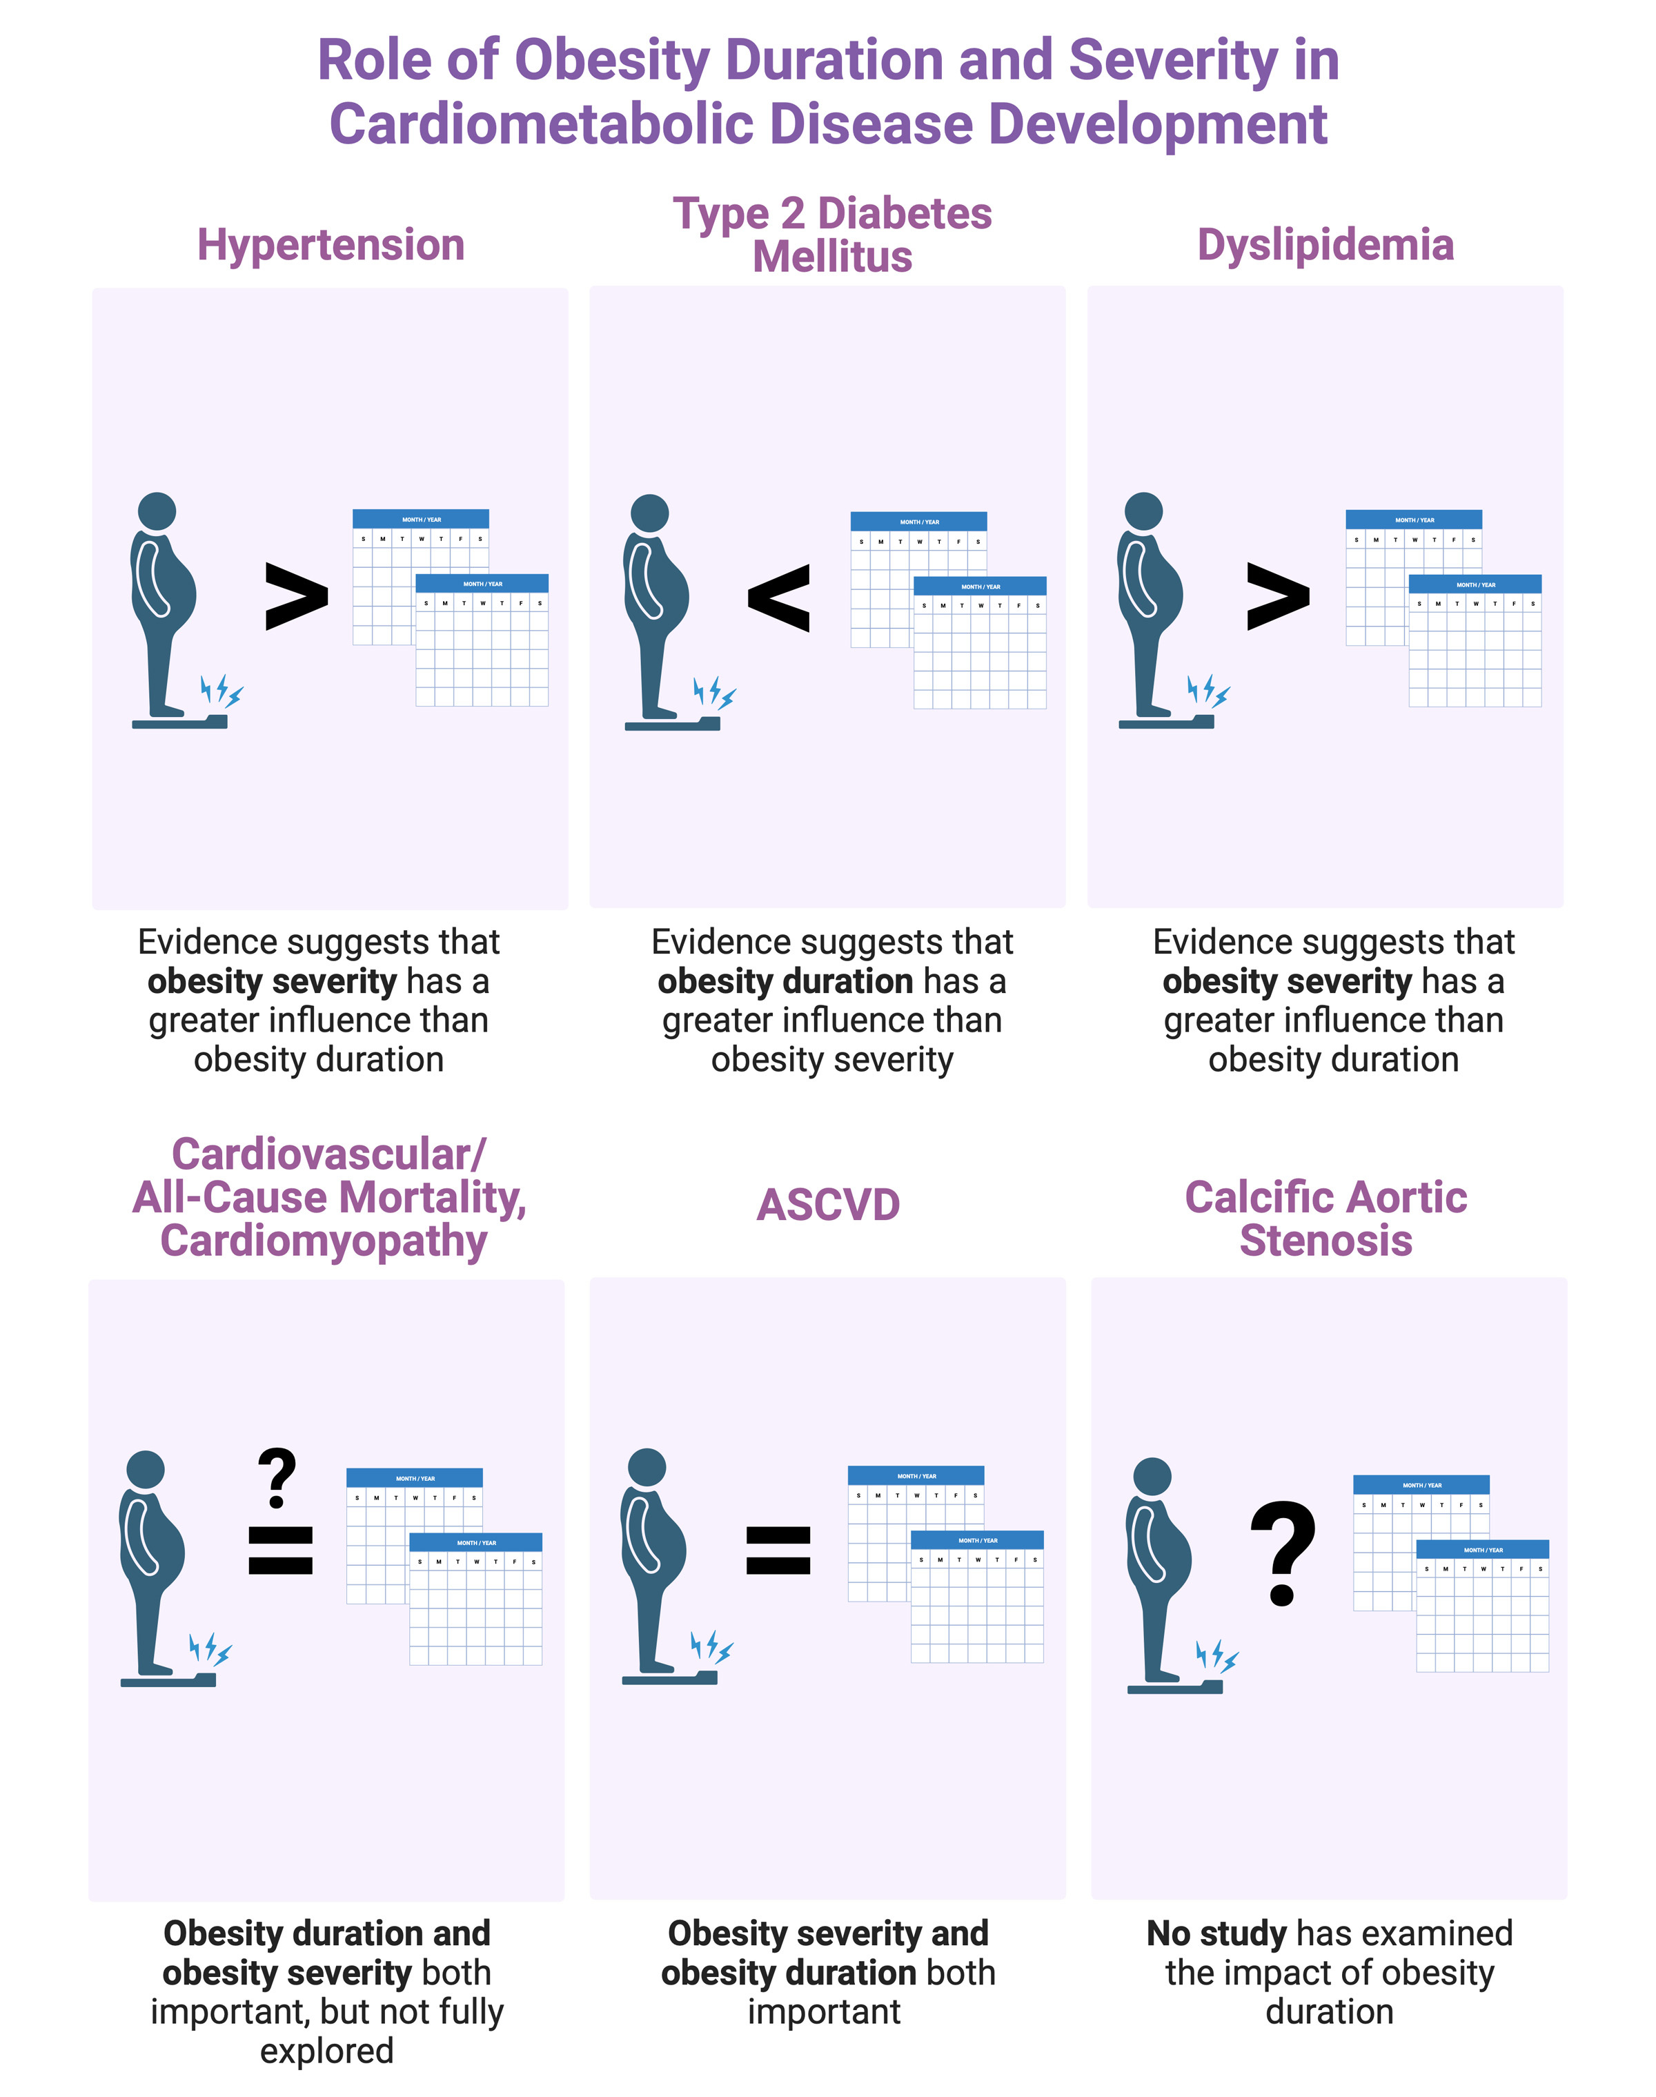
Sharnendra K et al. ATVB 2023

Slide 9
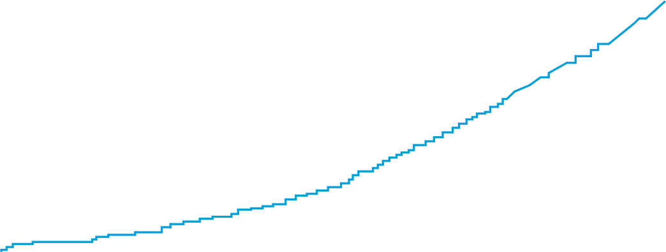
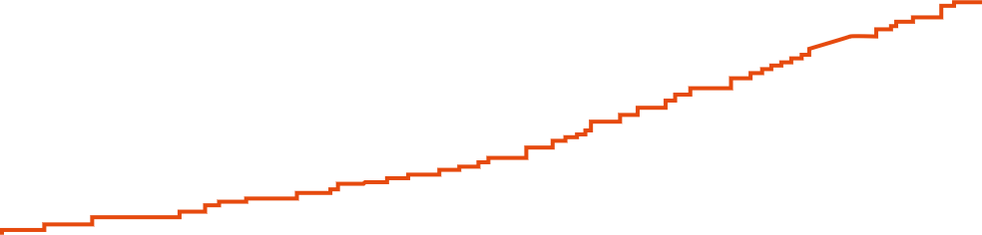
Incidence of Heart Failure over time according to body weight
15
Obesity
12
9
Cumulative incidence of heart failure, %
Overweight
6
Lean
3
0
0
3
6
9
12
15
18
21
24
Time (Years)
This study was done in a prospective cohort of 21,094 men (mean age, 53 years) without known coronary heart disease at baseline in the Physicians’ Health Study
Kenchaiah et al. Circulation 2009

Slide 10
Savji N et al. JACC: Heart Fail 2018

Slide 11
HR adjusted for sex, age, height, smoking status, level of education, marital status, physical activity, and alcohol consumption
Feng T et al. Circulation 2023

Slide 12
Powell-Wiley TM et al. Circulation 2021

Slide 13
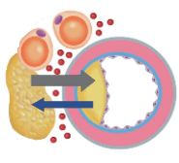
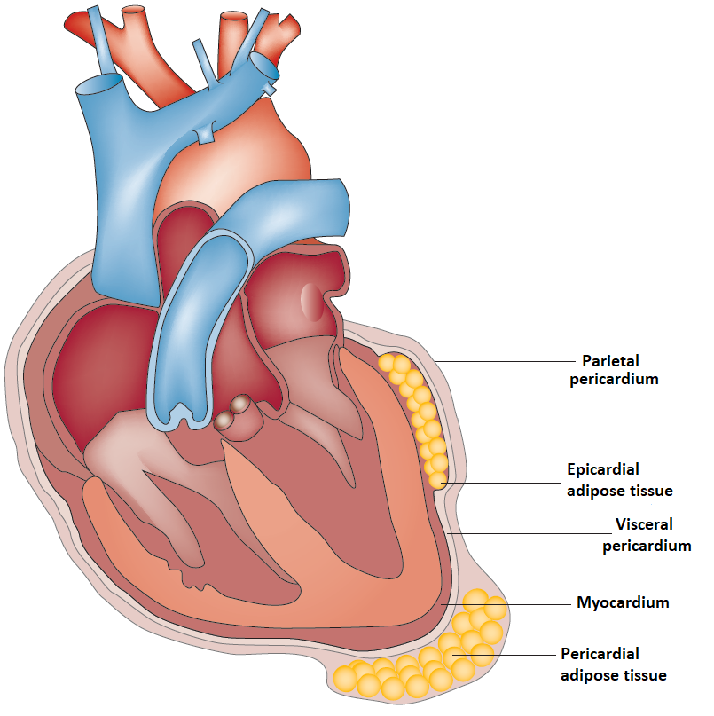
Pericoronary
adipose tissue
Epicardial adipose tissue (EAT) is the layer of AT located between the visceral layer of the pericardium and the myocardium, without an intervening fascial plane, supplied by branches of the coronary arteries.
The layer of EAT directly encompassing the coronary arteries represents the pericoronary adipose tissue (PCAT), being an integral part of the vascular wall itself.
The lack of an anatomical barrier allows crosstalk between EAT and the contiguous myocardium and coronary arteries.
Guglielmo M et al. Atherosclerosis 2021
Iacobellis G et al. Nat Rev Cardiol 2022

Slide 14
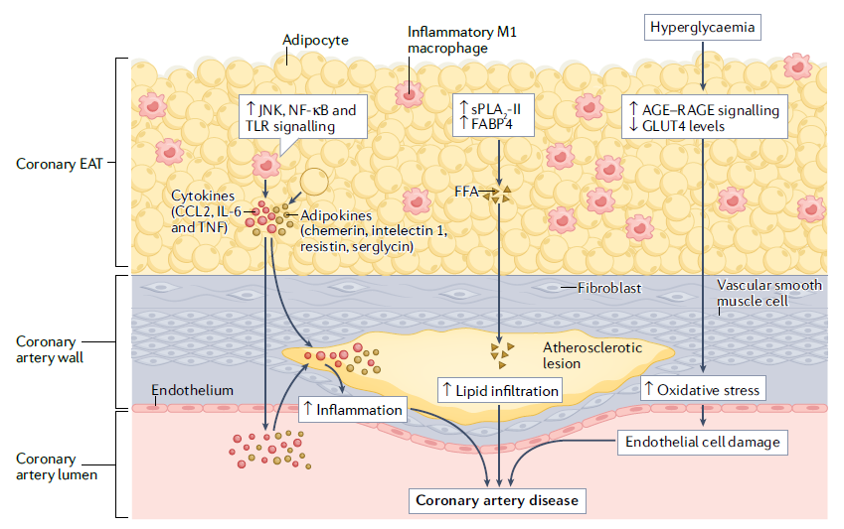
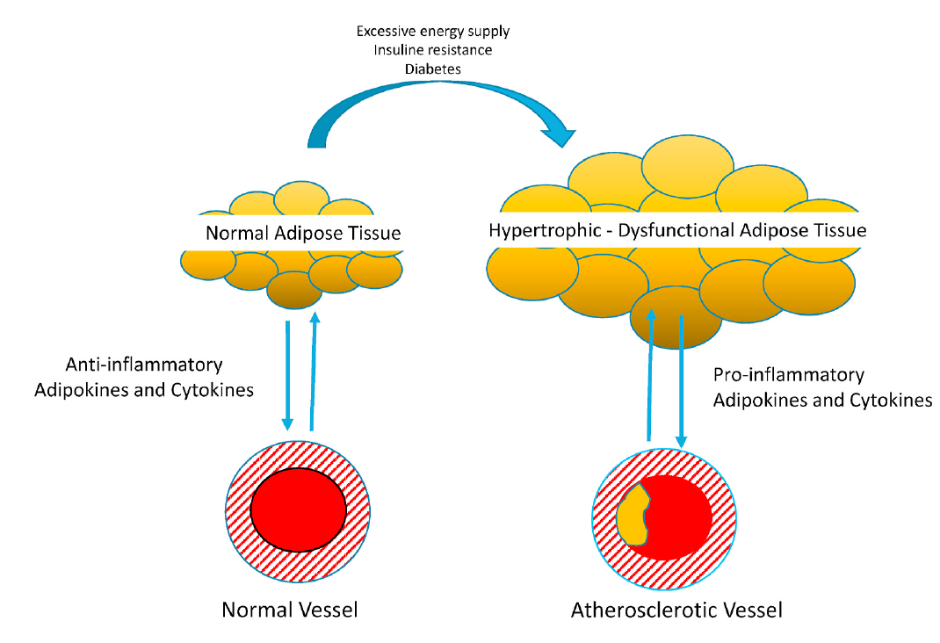
Physiopathology of EAT/PCAT
EAT functions:
Barrier against pathogens
Mechanical
Thermogenic
Metabolic
Paracrine/vasocrine secretion of numerous bioactive molecules
Under physiological conditions, EAT exerts a net vasodilatory, anti-oxidant and anti-inflammatory effect on the vasculature.
Under pathological conditions, there is a shift in the secretome of dysfunctional EAT, with increased production of pro-inflammatory adipokines and cytokines.
M. Guglielmo M et al. Atherosclerosis 2021
Iacobellis G et al. Nat Rev Cardiol 2022
Notes:
The mechanisms through which EAT can cause atherosclerosis
are complex and include inflammation, exaggerated
innate immunity response, oxidative stress, endothelial
damage, adipocyte stress, lipid accumulation and
glucotoxicity

Slide 15
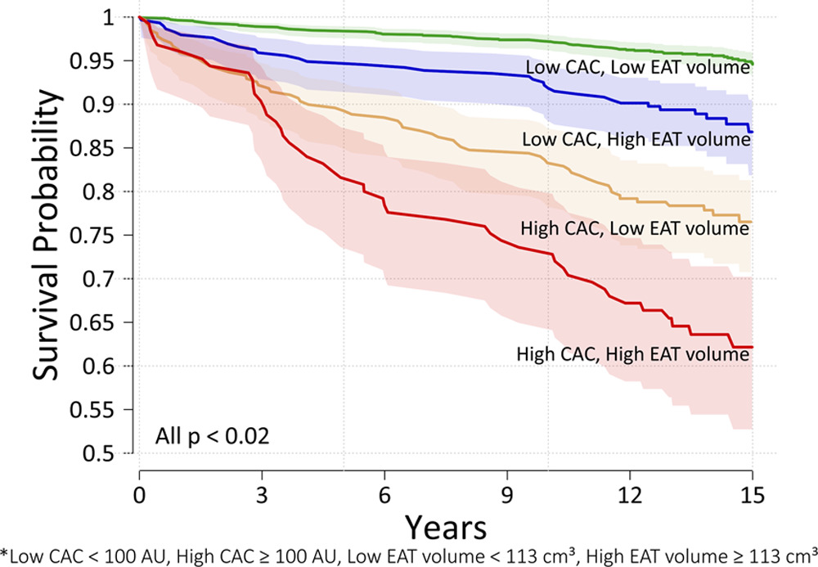
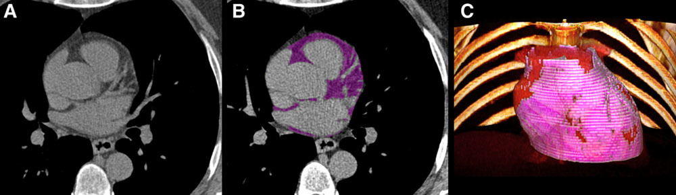
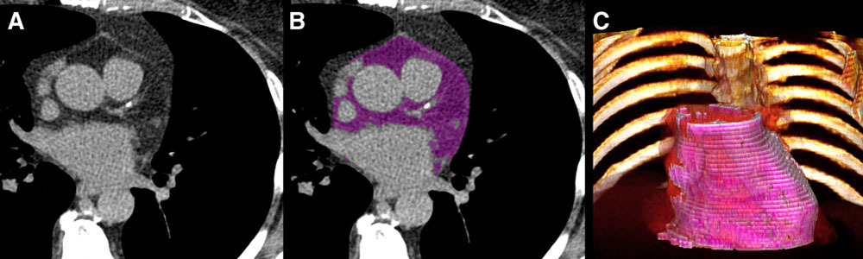
Correlation between epicardial adipose tissue & MACE
CAC = coronary artery calcium
Eisemberg E et al. Circ Cardiovasc Imaging 2020

Slide 16
Capristo E et al. Nutrition, Metabolism & Cardiovascular Diseases 2021

Slide 17
Capristo E et al. Nutrition, Metabolism & Cardiovascular Diseases 2021

Slide 18
How much weight loss is needed to improve obesity-related complications?
3 to 10%
3 to >15%
3 to >15%
5 to 10%
5 to 10%
5 to 10%
5 to 10%
5 to >15%
5 to 15%
10%
10%
10 to 15%
Cefalu et al. Diabetes Care 2015; Lean et al. Lancet 2018 Hannah & Harrison. Clin Liver Dis 2016

Slide 19
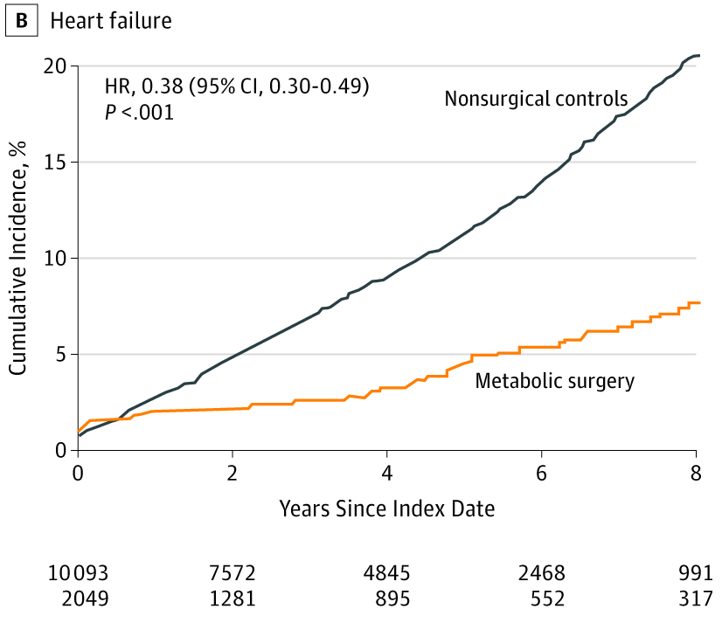
Metabolic surgery is associated with decreased risk of developing heart failure
Heart failure – cumulative incidence
20
HR 0.38
[95% CI 0.39-0.49]
p<0.001
Non-surgical
controls
15
10
Cumulative incidence (%)
5
Metabolic surgery
0
0
2
4
6
8
Years since index date
10093
2049
7572
1281
4845
895
2468
552
991
317
Aminian et al. JAMA 2019

Slide 20
Carlsson LMS et al. NEJM 2020

Slide 21
17.604 pazienti con precedente malattia CV e BMI >27 kg/m² senza diabete
Randomizzati a semaglutide 2.4 mg s.c./7 gg
Endpoint primario: morte cardiovascolare, infarto e ictus non fatali
  Calo ponderale del 9.4%
Lincoff AM et al. for the SELECT Trial investigators. NEJM 2023

Slide 22
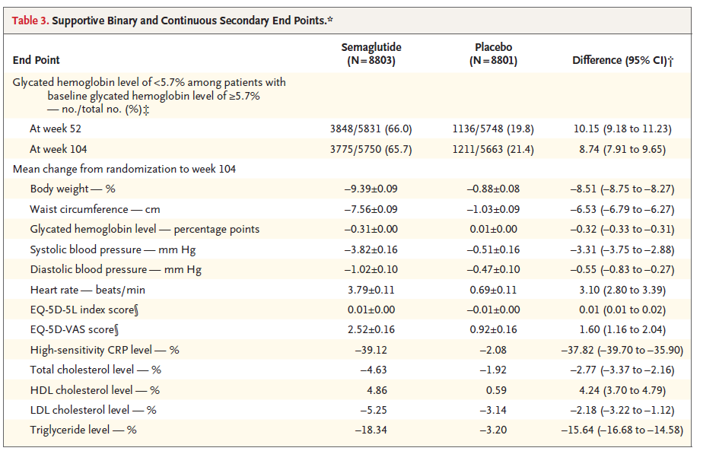
Lincoff AM et al. for the SELECT Trial investigators. NEJM 2023

Slide 23
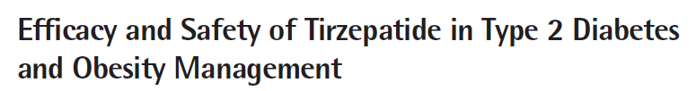
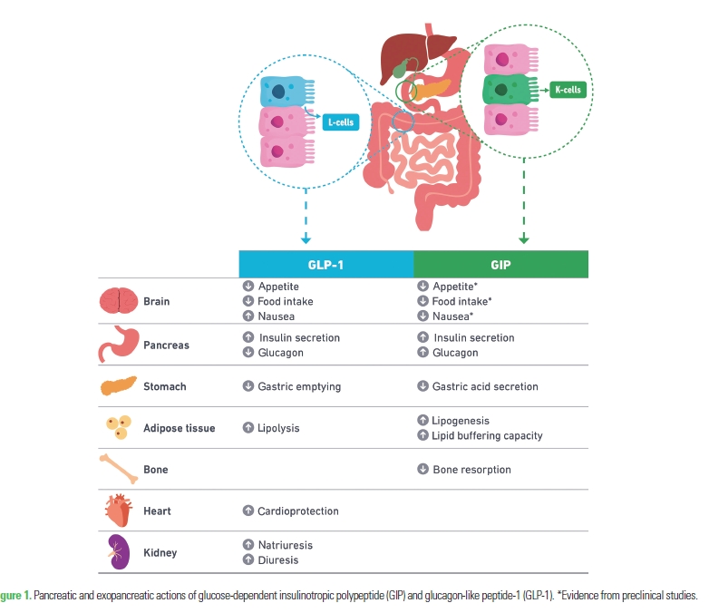
Sinha R et al. Journal of Obesity & Metabolic Syndrome 2023

Slide 24
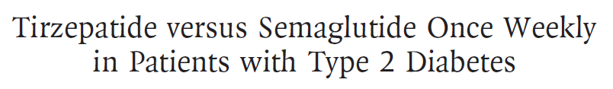
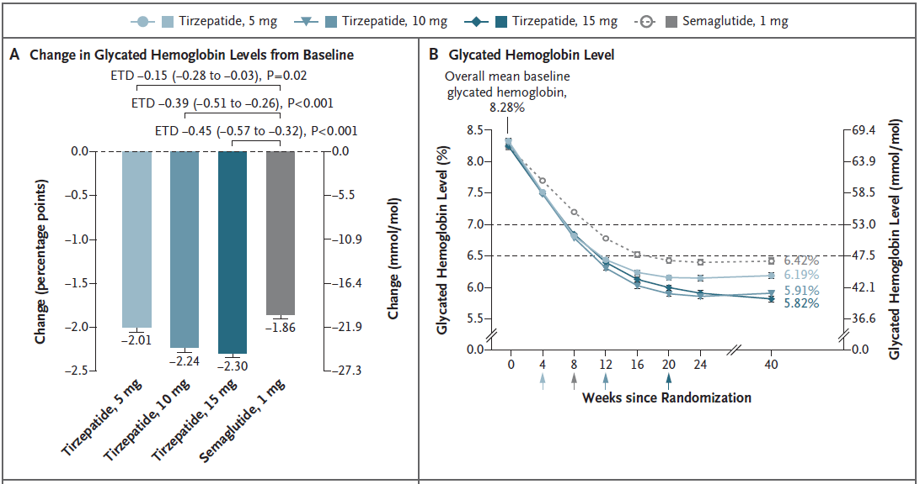
Frias JP et al. for the SURMOUNT-2 Invest. N Engl J Med 2021

Slide 25
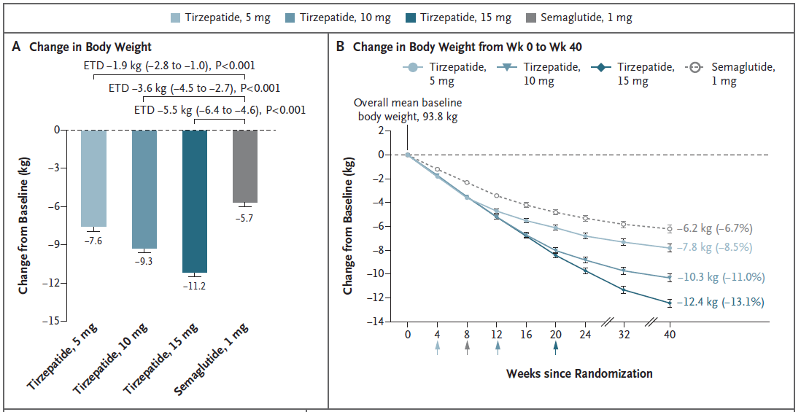
Frias JP et al. for the SURMOUNT-2 Invest. N Engl J Med 2021

Slide 26
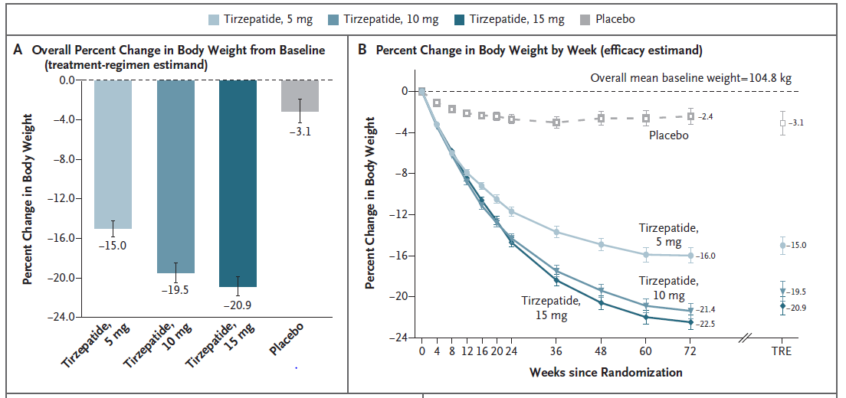
Jastreboff AM et al. for the SURMOUNT-1 Invest. N Engl J Med 2022

Slide 27
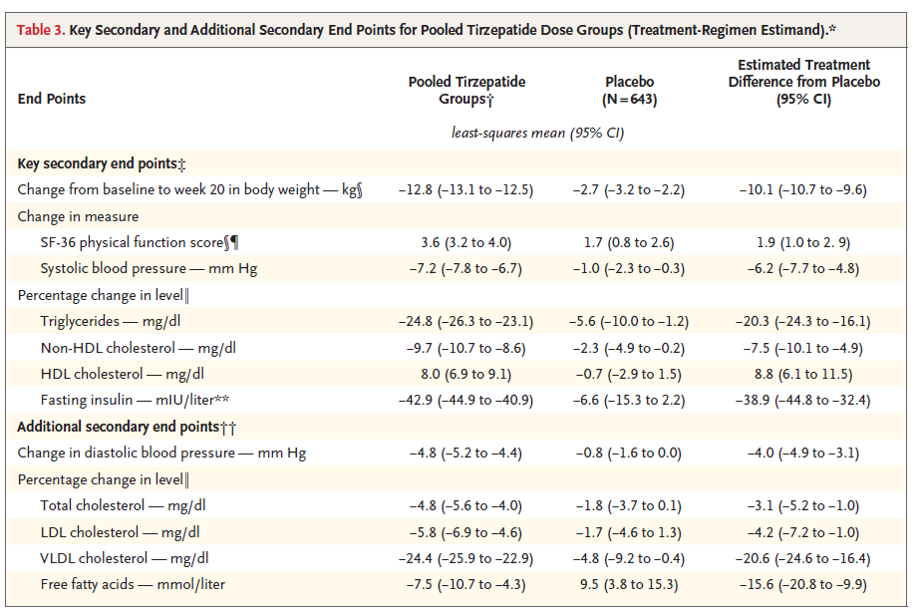
Jastreboff AM et al. for the SURMOUNT-1 Invest. N Engl J Med 2022

Slide 28
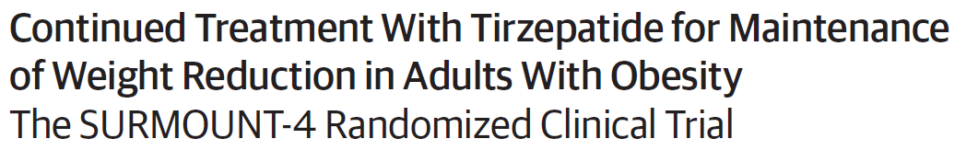
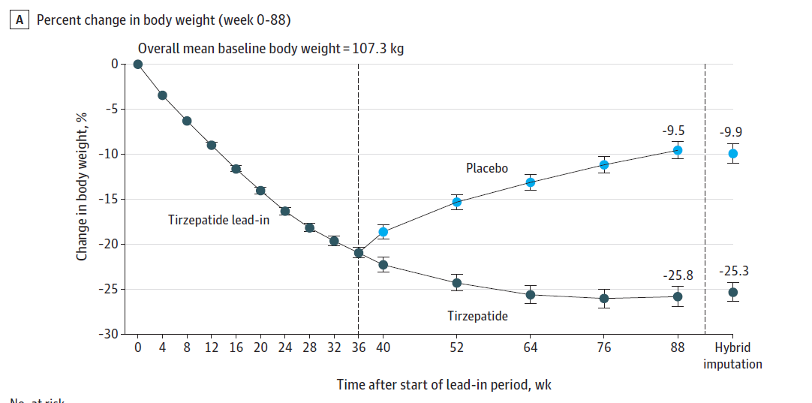
Aronne LJ et al. for the SURMOUNT-4 Invest. JAMA 2024

Slide 29
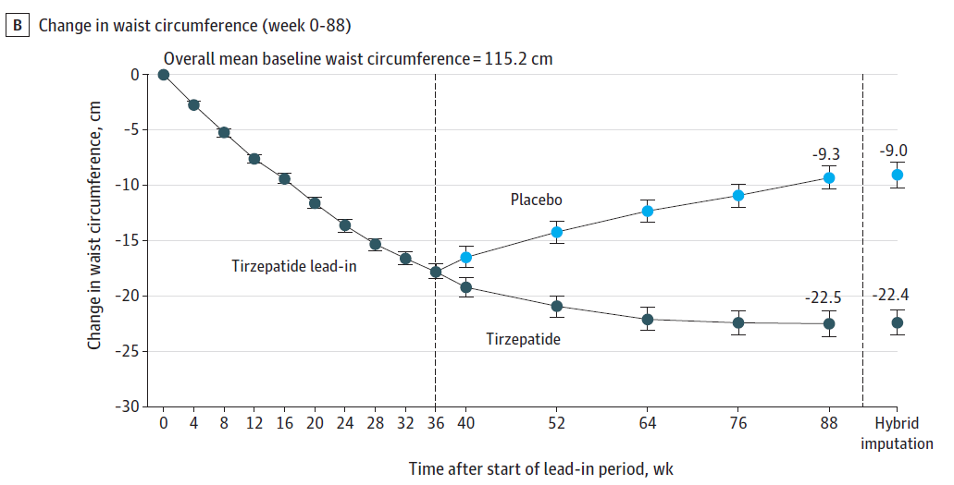
Aronne LJ et al. for the SURMOUNT-4 Invest. JAMA 2024

Slide 30
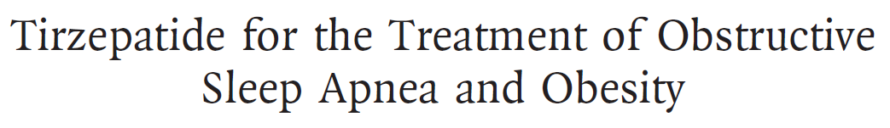
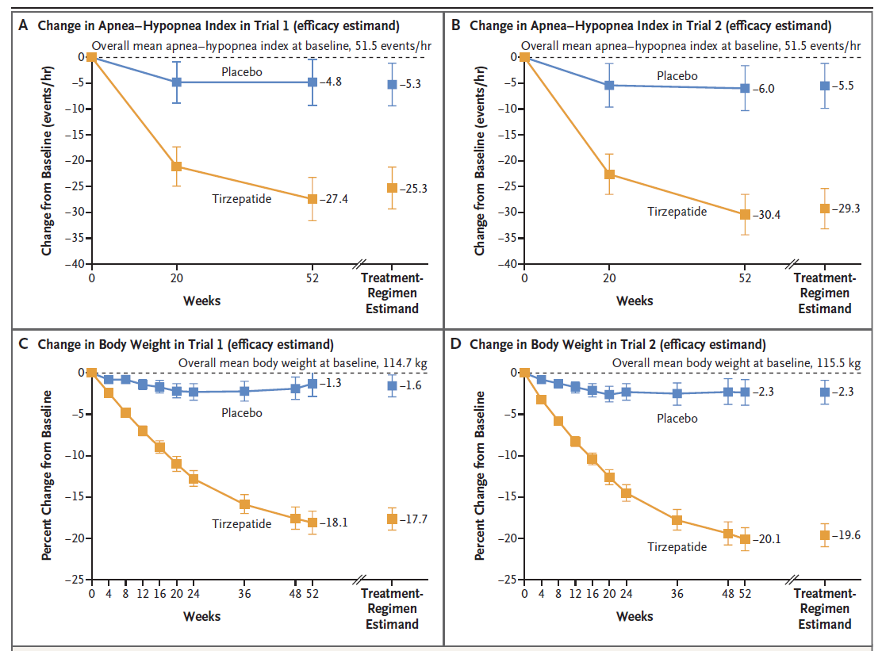
Trial 1: no CPAP
Trial 2: CPAP
Malhotra A et al. for the SURMOUNT-OSA Invest. N Engl J Med 2024

Slide 31
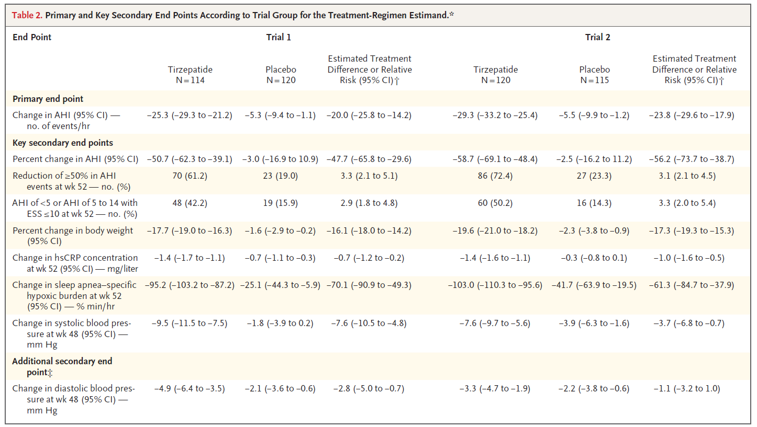
Malhotra A et al. for the SURMOUNT-OSA Invest. N Engl J Med 2024

Slide 32
Conclusioni
Oltre a numerose conseguenze per la salute, l'obesità contribuisce alle malattie cardiovascolari indirettamente attraverso lo sviluppo di fattori di rischio e direttamente attraverso meccanismi biologici.
La riduzione/normalizzazione del peso corporeo si associa ad una riduzione del rischio cardiovascolare
È evidente la necessità di raddoppiare gli sforzi per colpire il rischio cardio-metabolico legato all'obesità come strategia per combattere le malattie cardiovascolari

Slide 33
Grazie

